Slide 2
Stop, Speak, Support Day
Anti-Bullying Week
Choose Respect

Slide 3
What is cyberbullying?

Slide 4
Cyberbullying is…
Cyberbullying is bullying that takes place using technology.
e.g using mobile phones, social media, instant messenger, emails.

Slide 5
Who could be affected by cyberbullying?

Slide 6
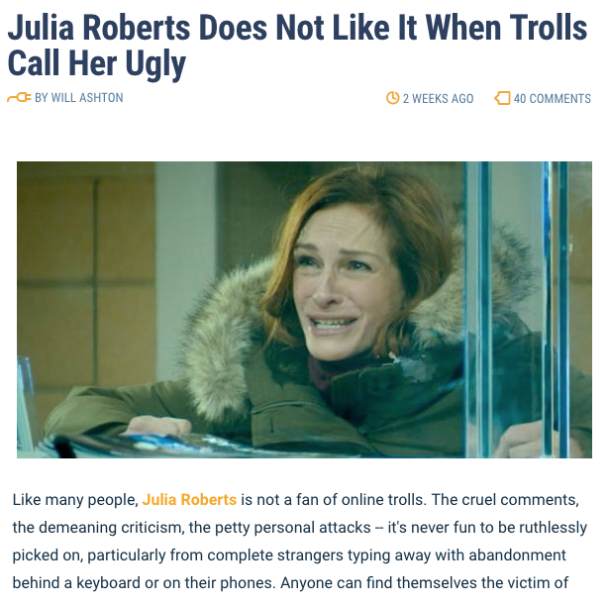
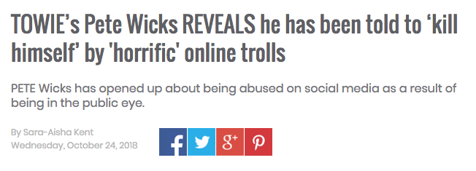
Who is affected by cyberbullying?
Everyone can be!

Slide 7
What can you do? Stop!
Always stop and think before getting involved.
Think about what you post online, keep personal information such as your address private

Slide 8
What can you do? Speak!
Always tell a teacher, a friend or tootoot!
Report any cyberbullying you see, even if it’s not happening to you
If you see something that upsets you, screenshot the evidence and send to tootoot

Slide 9
What can you do? Support
If you see someone being cyberbullied send them a supportive message so they don’t feel alone.
Encourage them to speak to someone they can trust; a friend, teacher or tootoot.
If you are really worried about them you should speak to a trusted teacher or tootoot for them.

Slide 10
What is tootoot?
You can use tootoot to talk about anything that is making you feel unhappy or unsafe, no matter how big or small.
It is anonymous!
Your message goes through to a trusted teacher who will help you.
You can login to tootoot at yourschoolname.tootoot.co.uk or download the app!
If you can’t remember your login please speak to teachersname who will help you reset it.

Slide 11
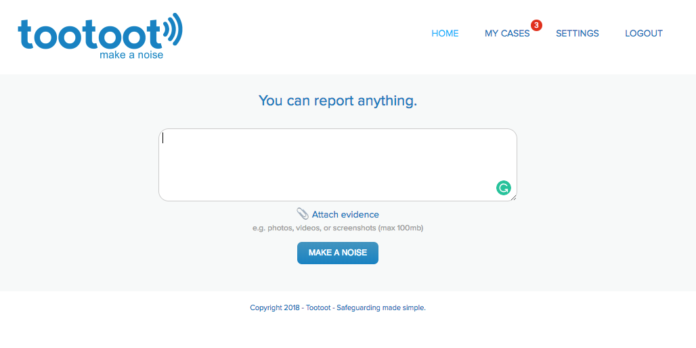
What is tootoot?

Slide 12
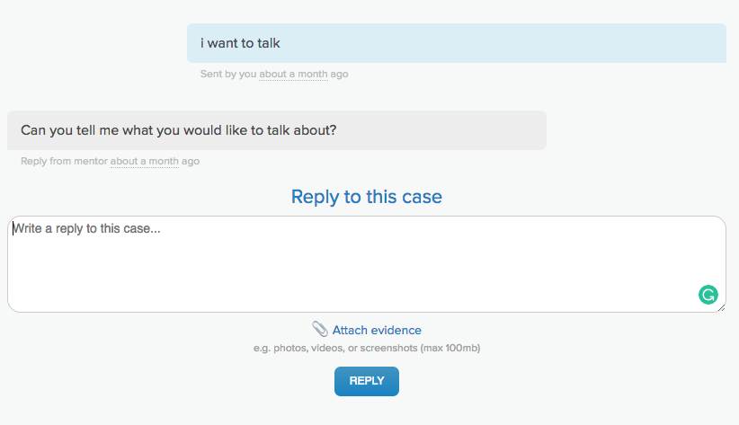
What is tootoot?

Slide 13
Reflection
Think about how you will use stop, speak, support
to make the internet a safer place to spend time.

Slide 14
Thank you!
Any questions?

