Slide 2
World Mental Health Day
“Young People and Mental Health in a Changing World”

Slide 3
Good Mental Health is: We realise our own potential We can cope with the normal stresses of life We are productive We can contribute to our community

Slide 4
Assembly Objective
To understand that technology can have a positive and negative effect on our mental health
To consider how we can keep ourselves safe and happy when we use technology

Slide 5
Who has access to a mobile phone?

Slide 6
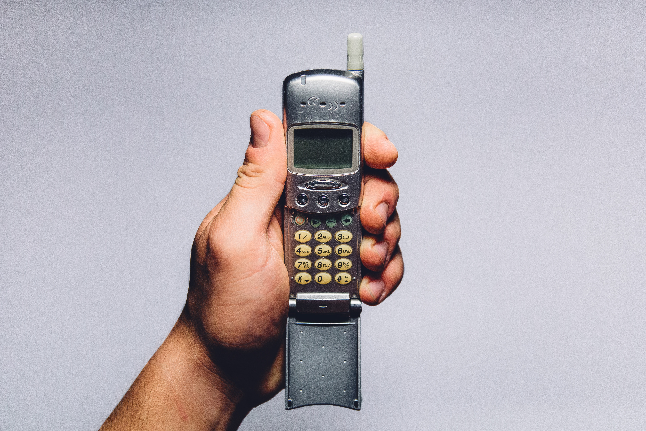
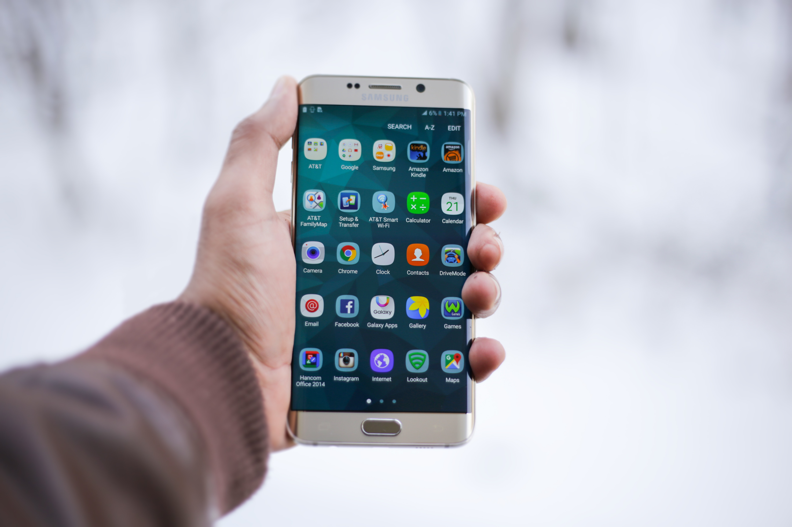
Changing technology now means that we can receive messages and information day and night.

Slide 7
Technology Helps Us:
Learn
Keep in touch with friends
Improve our language and problem solving skills.
This all has a positive impact on our mental health!

Slide 8
Technology can make us feel unhappy or unsafe…
1 in 4 children have experienced something upsetting on a social media site.
1 in 8 young people have been bullied on social media.
This has a negative impact on our mental health.
38% of young people believe social media has a negative impact on how they feel about themselves

Slide 9
How can we keep ourselves happy and safe online?
Remember F.E.T.C.H!
Fault – Always remember it’s not your fault
Evidence – if something upsets you, screenshot the evidence and send to tootoot.
Think – always think before you post things online
Choose - the sites you use carefully. Are they right for you?
Help – if something is worrying you, ask for help from a friend, a teacher or tootoot.

Slide 10
Close your eyes and reflect…
Think about who you want to be online, and how you can make being online a happier and safer place for you and the people around you.

Slide 11
What have we learned?
Technology can have positive and negative effects on our mental health.
We understand how to use technology in a safe way for ourselves and the people around us
We should always tell a teacher, a friend or tootoot if something makes us feel unhappy or unsafe.

Slide 12
Thank you!
Any questions?

