Slide 1
Welcome!

Slide 2
Assembly Objective
To understand that bullying can affect our mental health and that we should always speak-up if something happens that makes us feel unhappy or unsafe.

Slide 3
True or False?
1 in 8 young people have been bullied on social media.

Slide 4
True!
1 in 8 young people have been bullied on social media.

Slide 5
True or False?
1.5 million children are bullied every year

Slide 6
True!
1.5 million children are bullied every year

Slide 7
Bullying such as name-calling, being nasty on social media or physical bullying has a negative effect on our mental health.

Slide 8
We should speak-up when…
We’re feeling unhappy
We’re feeling scared
We’re being bullied or witness bullying
We’re worried about something or someone

Slide 9
Who can we speak to?
A teacher!
A trusted adult!
tootoot!

Slide 10
What is tootoot?
https://www.youtube.com/watch?time_continue=54&v=MEEvy4ho68s

Slide 11
How can tootoot help?
Tootoot is a safe and confidential place to talk about anything that is worrying you.
“I reported my worries and anxieties about my exams to tootoot”
Pupil from the North West

Slide 12
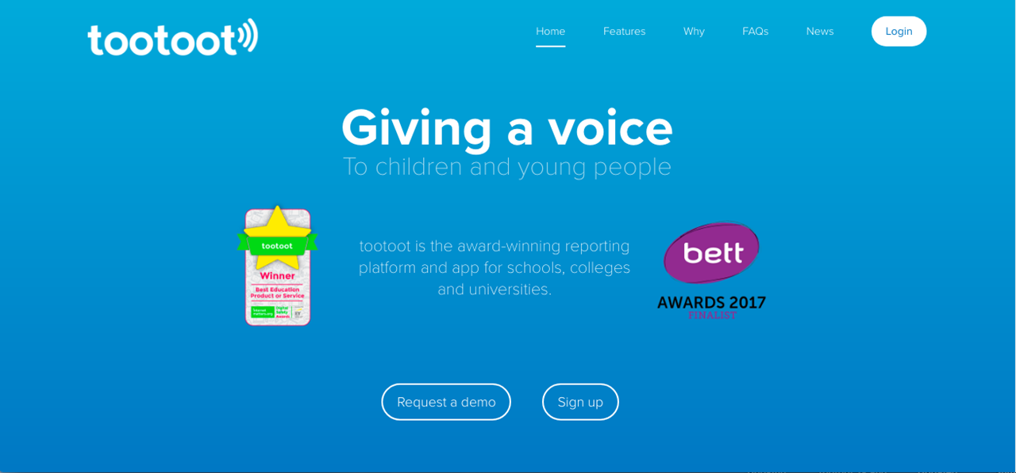

Slide 13
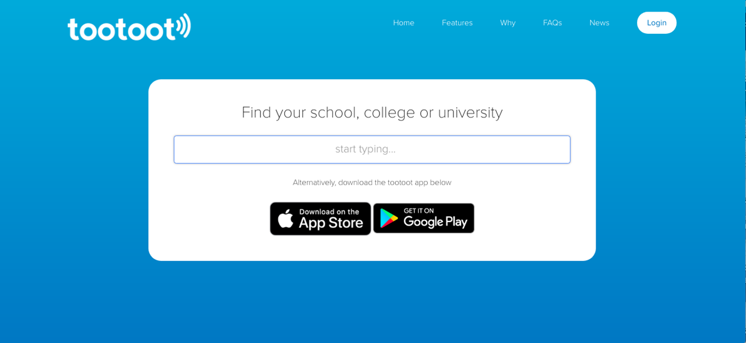

Slide 14
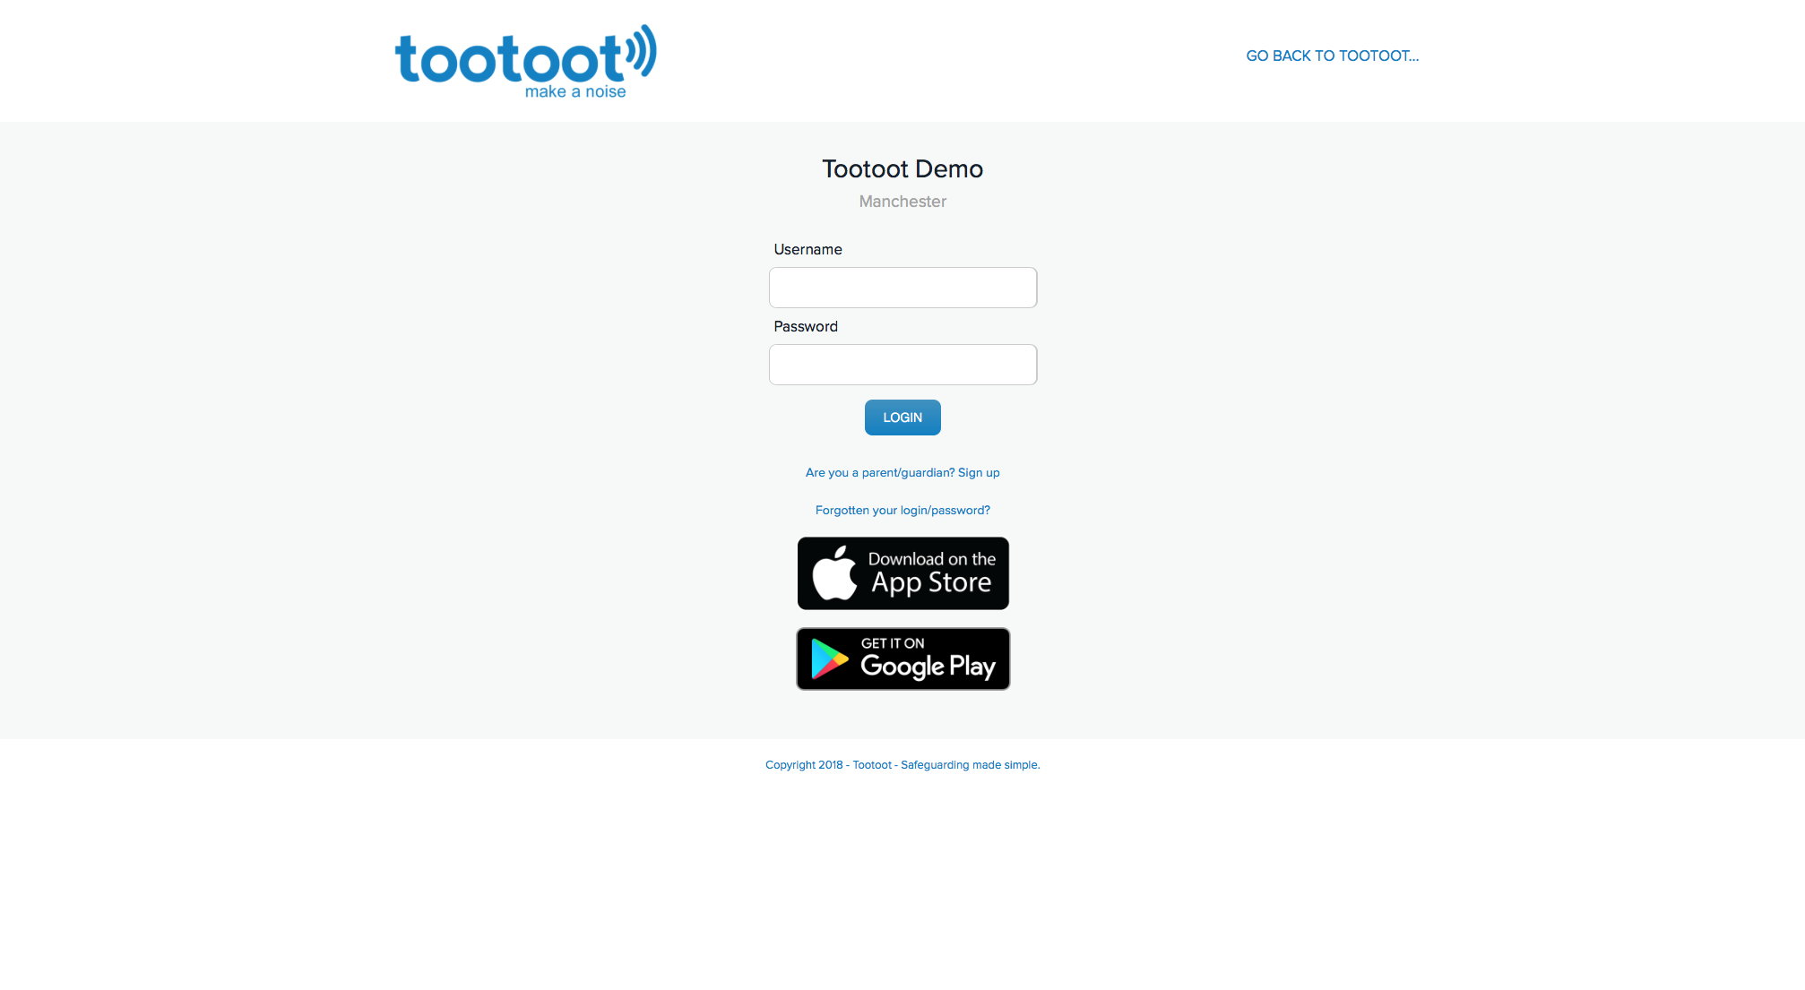

Slide 15
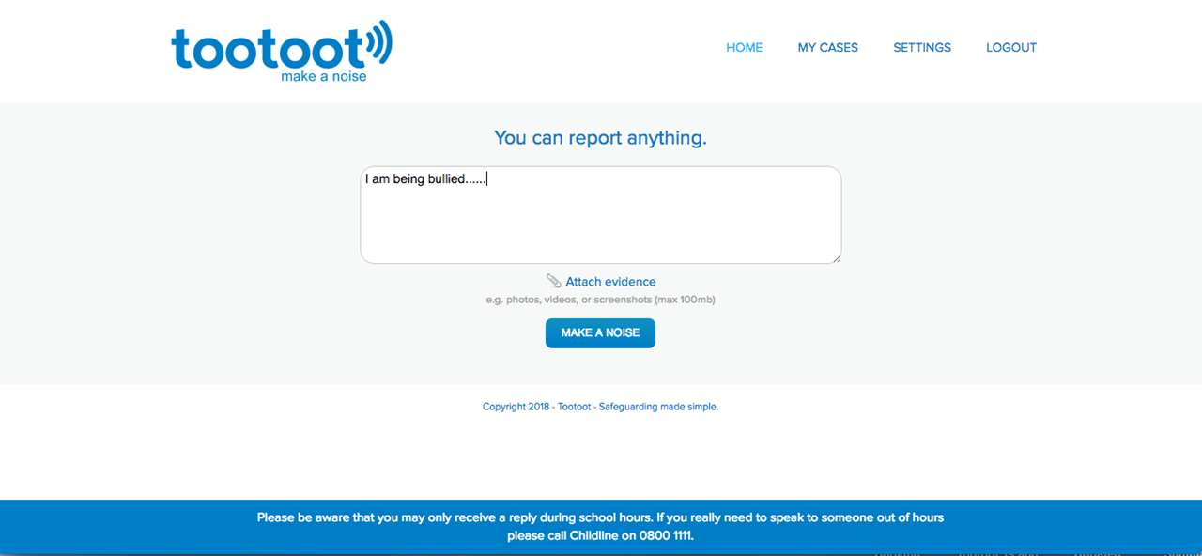

Slide 16
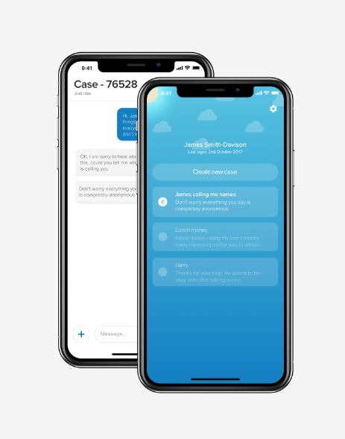
The tootoot app
Download tootoot onto your smartphone or tablet from the app store or google play.

Slide 17
What have we learned?
Bullying can have a negative effect on our mental health
Always tell a teacher, a friend or tootoot if something is making you feel unhappy or unsafe.
If you forget your tootoot login please speak to [INSERT NAME HERE]

