Slide 1
Resilience

Slide 2
What is resilience?

Slide 3
Success
What people think it looks like
What is really looks like

Slide 4
Guess the person

Slide 5
Can you guess who said this?
"An exceptionally short-lived marriage had imploded, and I was jobless, a lone parent, and as poor as it is possible to be in modern Britain, without being homeless ... By every usual standard, I was the biggest failure I knew.”

Slide 6
Clue 1
They wrote a book that got rejected 12 times.
One of the publishers that rejected the book didn’t send the sample back, just a rejection note.
“I really minded about the folder, because I had almost no money and had to buy another one.”

Slide 7
Clue 2
500 million copies of the books have been sold since 1997.
And, one of the books was the fastest selling fiction book of all time.

Slide 8
And the person is…

Slide 9
J.K. Rowling

Slide 10
But resilience isn’t the only thing that can help you through tough times, you also have tootoot.

Slide 11
How can tootoot help?
Tootoot is a safe and private place to talk about anything that is worrying you.

Slide 12
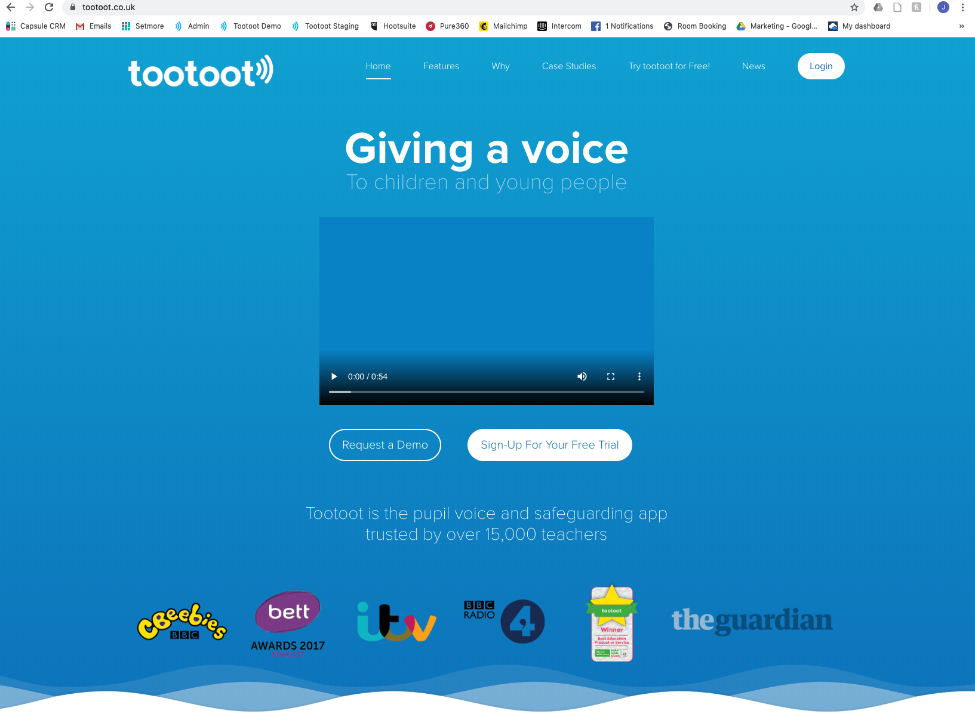

Slide 13
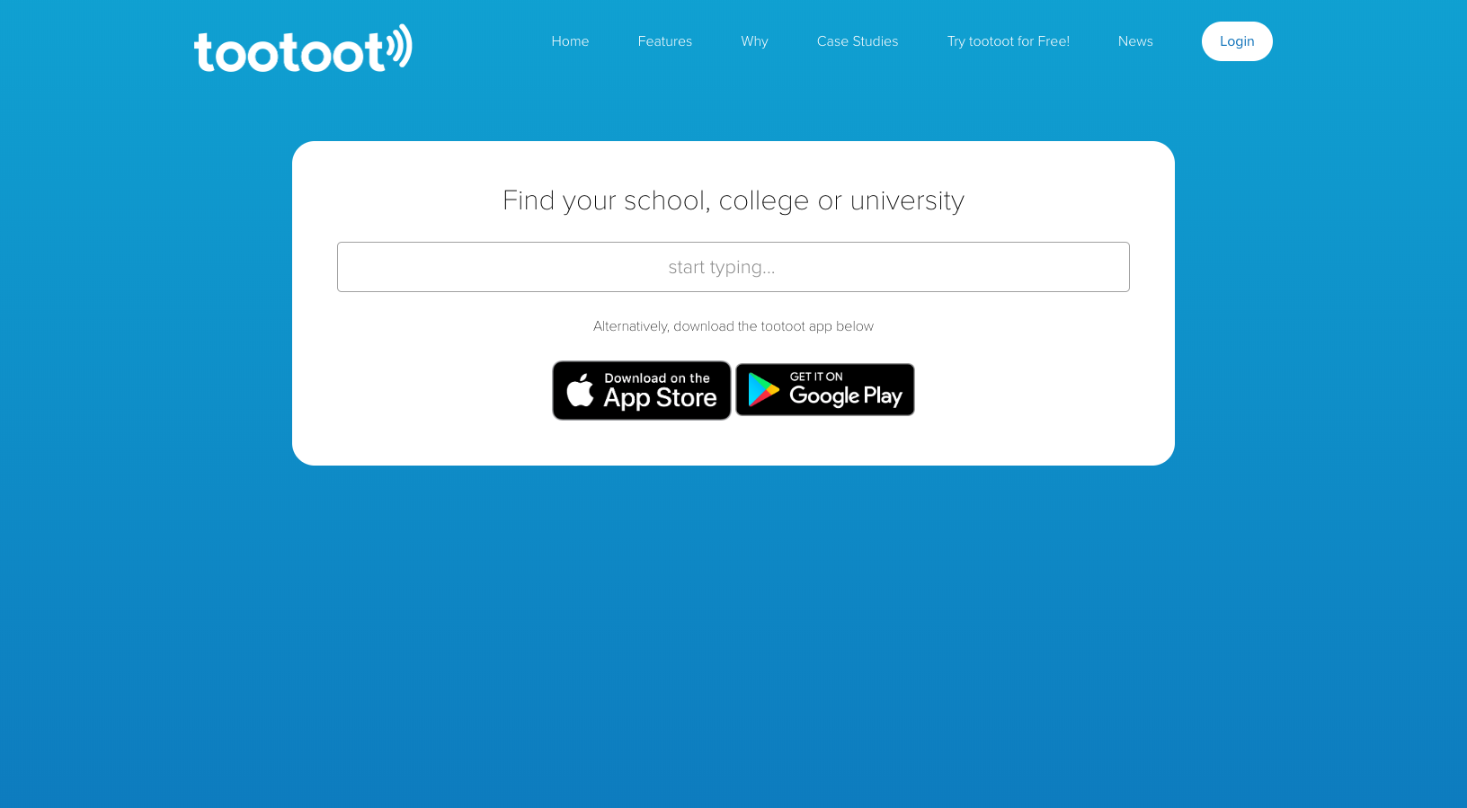

Slide 14
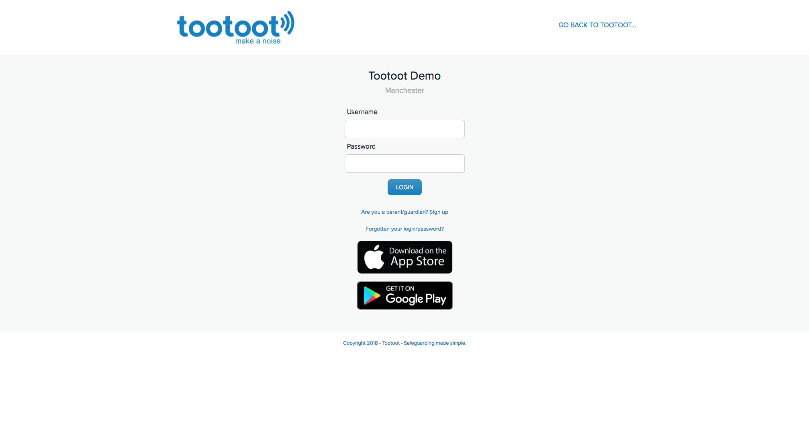

Slide 15
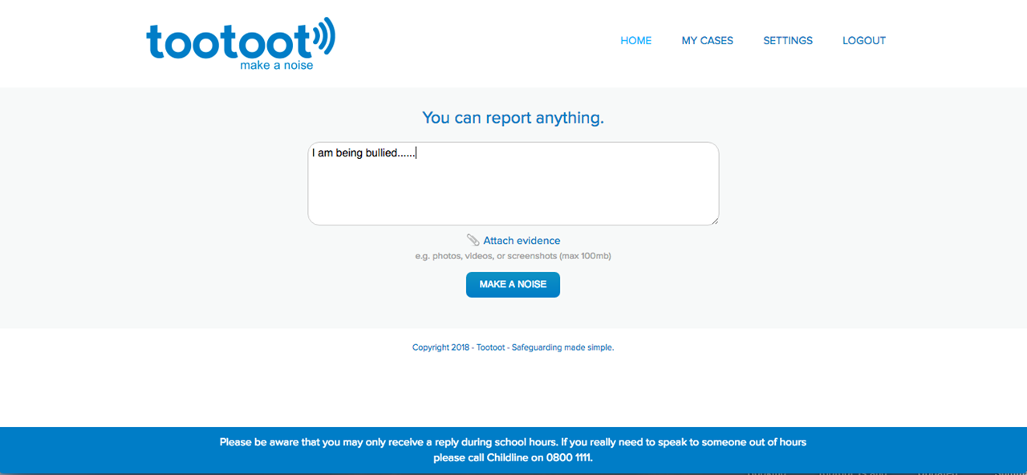

Slide 16
We are always here to support and help you thrive this new school year.
Always tell a teacher, a friend or tootoot if something is making you feel unhappy or unsafe.
If you forget your tootoot login please speak to [INSERT NAME HERE]

Slide 17
Any Questions?

