Slide 1
Welcome!

Slide 2
What do all these people have in common?

Slide 3
Successful
Smart
Inspirational
Powerful

Slide 4
Faced rejection
Underestimated
Underdogs

Slide 5
What contributed to their successes?

Slide 6
Resilience

Slide 7
Resilience: a quality that allows some people to be knocked down by life and come back at least as strong as before.

Slide 8
When can resilience be useful in school?
When you try out a new sport and you’re not that great at it the first time
Not getting the grade you expected
Finding a piece of class work particularly hard
Not being picked for the part you wanted in the school play

Slide 9
What things can you do to boost your resilience?

Slide 10
Close your eyes and reflect
How can you apply resilience to your life?
How can you be more resilient in your next lesson?

Slide 11
Building resilience doesn’t have to be all down to you. If there’s anything that’s troubling you are are struggling to cope tootoot can help.

Slide 12
How can tootoot help?
Tootoot is a safe and confidential place to talk about anything that is worrying you.
“I reported my worries and anxieties about my exams to tootoot”
Pupil from the North West

Slide 13
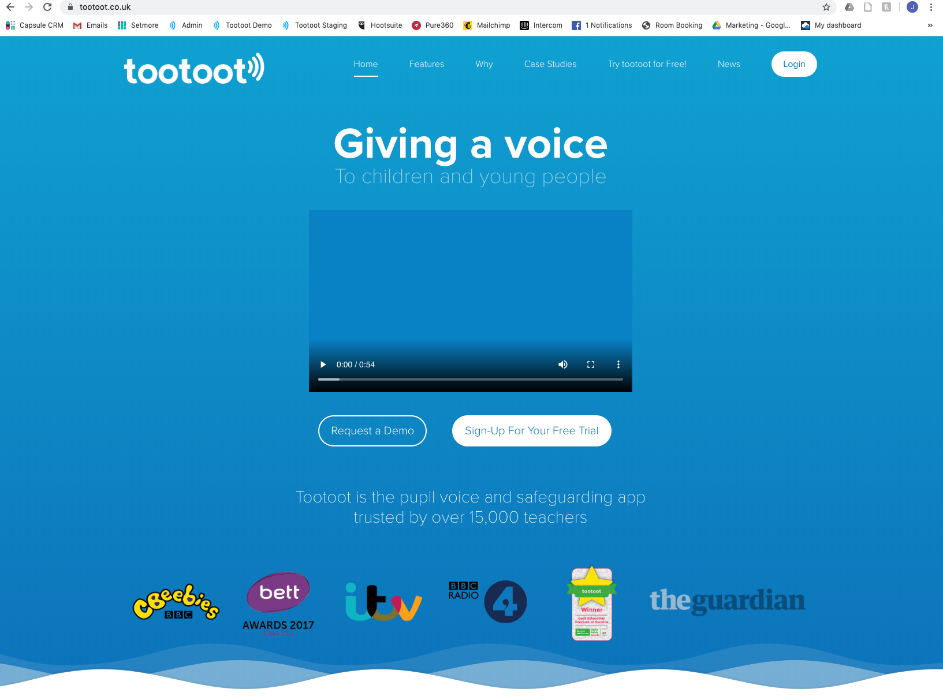

Slide 14
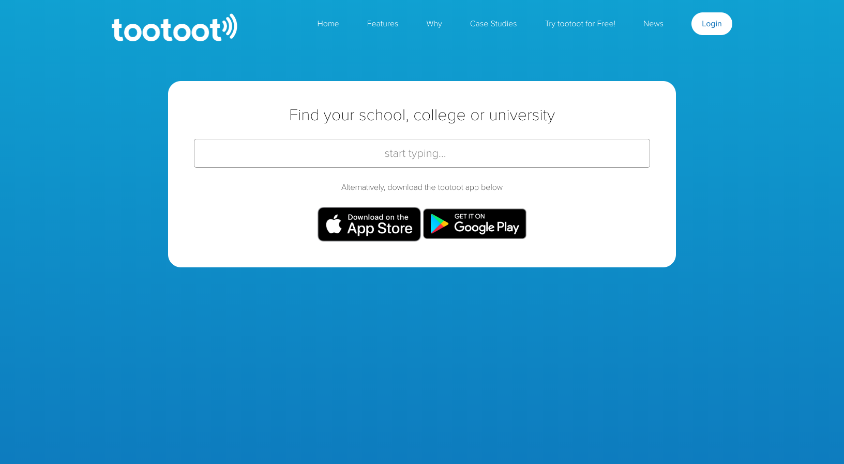

Slide 15
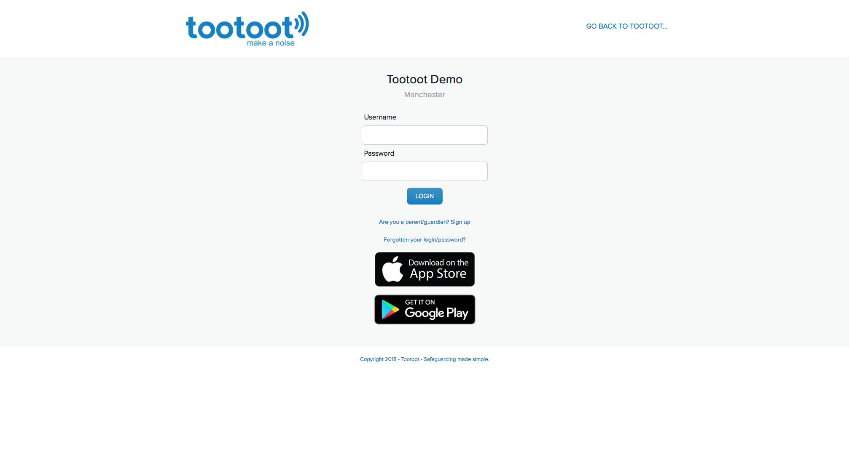

Slide 16
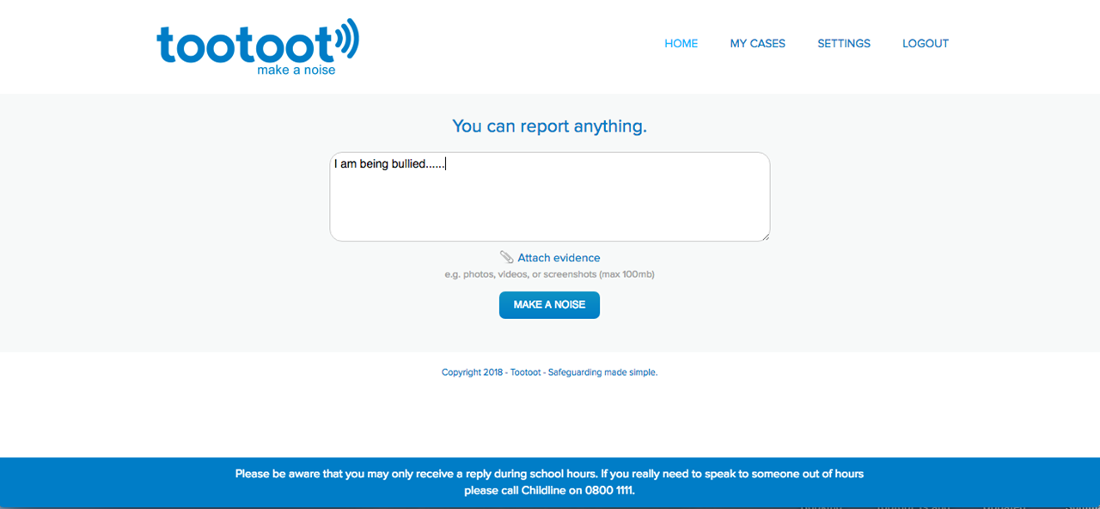

Slide 17
We are always here to support and help you thrive this new school year.
Always tell a teacher, a friend or tootoot if something is making you feel unhappy or unsafe.
If you forget your tootoot login please speak to [INSERT NAME HERE]

