Slide 1
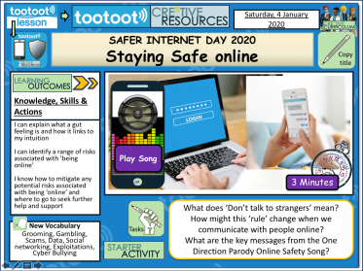
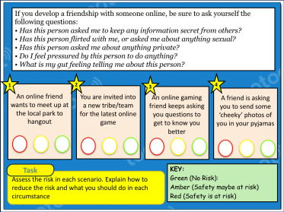
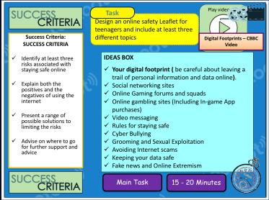
SAFER INTERNET DAY 2020
STAYING SAFE ONLINE LESSON
LESSON POWERPOINT & WORK SHEETS

Slide 2
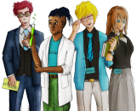
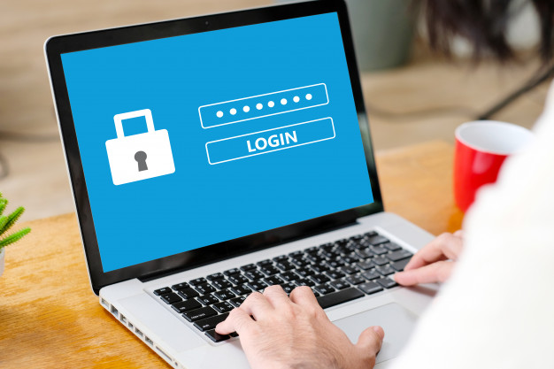
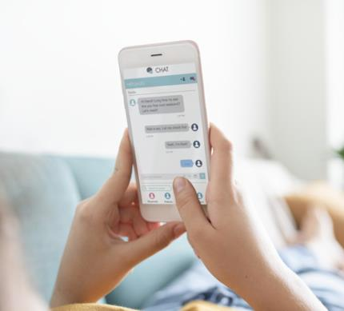
SAFER INTERNET DAY 2020
Staying Safe Online
Knowledge, Skills & Actions
I can explain what a ‘gut feeling’ is and how it links to my intuition
I can identify a range of risks associated with ’being online’
I know how to mitigate any potential risks associated with being ‘online’ and where to go to seek further help and support
Play Song
Click Here
3 Minutes
What does ‘don’t talk to strangers’ mean?
How might this ‘rule’ change when we communicate with people online?
What are the key messages from the ‘One Direction Parody Online Safety Song’?
New Vocabulary
Grooming, Gambling, Scams, Data, Social Networking, Exploitations, Cyber Bullying
Notes:
TEACHER NOTES & IDEAS
Remind students of the learning journey (What theme you are doing – Possibly recap what they can remember from last lesson.
Always check the content of any lesson and videos linked before teaching to ensure suitability for your classroom and your school

Slide 3
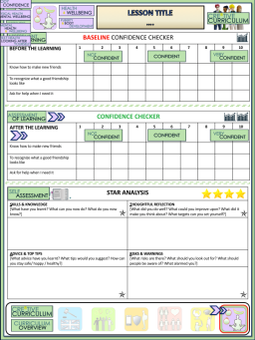
Safer Internet Day 2020
Staying Safe Online
BASELINE CONFIDENCE CHECKER
BEFORE LEARNING | 1 | 2 | 3 | 4 | 5 | 6 | 7 | 8 | 9 | 10
I listen to my gut feeling about online situations and choices
I understand a wide range of risks associated with internet use
I know how to reduce the risks associated with ‘being online’
Complete a baseline assessment of where you think you are at for this lesson
(Discussion or complete sheet)
2 Minutes
I’m not confident at all
I’m getting more confidence
Confident
Very
confident
Super
confident
Notes:
TEACHER NOTES & IDEAS
This could be done by writing a number down in the books
Show of fingers in the air. /Red amber Green Cards
Quick Partner Discussion
Print off the Assessment Opportunity Sheet – Fill in the Baseline Confidence Checker

Slide 4
 | DID? | MIGHT? | COULD? | CAN? / WILL? | IS? DOES?
HOW?
WHAT?
WHERE?
WHO?
WHY?
SECOND
FIRST
Using the grid above come up with three questions about the image
Tasks
2 Minutes
Notes:
TEACHER NOTES & IDEAS
Get students to come up with questions using the prompts on the board
Try to get them to think of high level order questions and look past just the image
Extension – Have students try to come up with answers to other students questions

Slide 5
Safer Internet Day THEME 2020: Together for a better internet
History of Safer Internet Day
2019
Global Theme: Together for a better Internet.
2018
Global Theme: Create, Connect and Share Respect: A better Internet starts with you”.
2017
Global Theme: Be the change: Unite for a better Internet
What do you notice is common amongst all the chosen themes?
Did you know?
The UK safer Internet Centre which coordinates Safer Internet Day each year was set up in 2011 with the help of the European Commission.

Slide 6
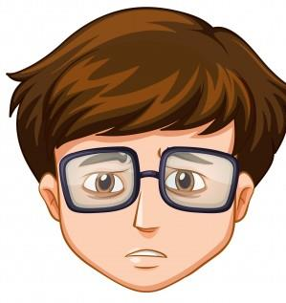
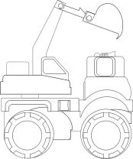
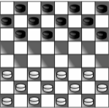
WHAT DO YOU THINK?
Talking points
I think that …
I don’t think… is right because…
My opinion is…
I would argue the same because…
I disagree with… because…
Building on what ….
An alternate way of looking at this is…
I sort of agree, however….
In my view…
I would challenge what… said because …
“The Internet can be a safe place for students”
?
AGREE
ALTERNATE IDEA
DEVELOP
Disagree
Develop
Challenge
Alternative
Idea/option
DISAGREE
CHALLENGE
Notes:
TEACHER NOTES & IDEAS
Ask students what they think of this image (collection of images)
Reveal the talking points after some discussion time
To provoke discussion with a quiet class – play devils advocate
Challenge a student to a debate

Slide 7
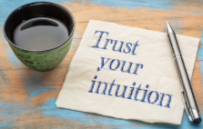
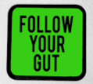
What is a gut feeling?
Have you ever had this feeling?

Slide 8
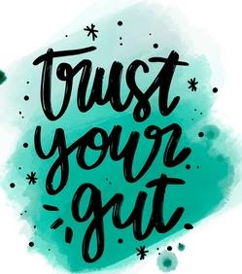
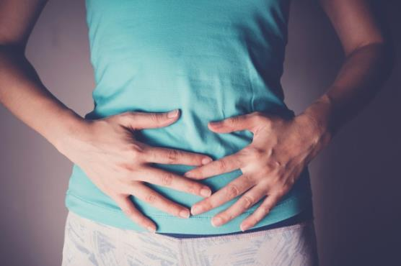
What is a gut feeling?
Your gut feeling could also be seen as your intuition about a situation.
It is the feeling you get about whether something is right or wrong and it may be warning you of risks or dangers about to happen.
Task
What online situations might give you a “gut feeling” that tells you that you may be at risk?

Slide 9
Being Safe Online
Play video
What thinking is needed? Next steps? Where are we now?
What is wrong? Is it safe? Can it be done?
Amaze.Org Video….
Task: Pick one or two colours and answer all the related questions
THINKING
JUDGEMENT
THINKING HATS
What facts do I know? What else do I need to know? What do I want to know?
How do I feel about this? What don’t I like about this? What do I like about this?
Can something be done? New ideas?
What are the solutions/ suggestions?
INFORMATION
FEELINGS
CREATIVITY
2 Minutes
Notes:
TEACHER NOTES & IDEAS
If the Video is short it may be worth playing it twice – 1st time let students watch carefully and 2nd time have students complete one or two of the hats
Short of Time – Play the video and Answer A few of the hats afterwards as a class
N.B This is a generic slide and sometimes the hats may not be appropriate for the video clip (if so delete or change accordingly to suit)
N.B Always check the video link is age appropriate to your class before showing student in the lesson.

Slide 10
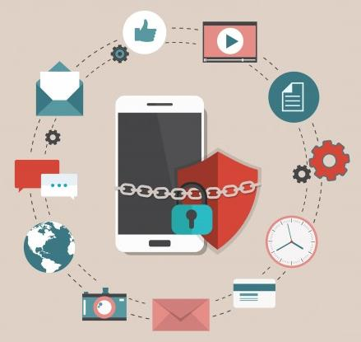
The Internet gives students a wide range of opportunities to connect with or learn from people who may not be in their circle of close friends.
This could be through games, social network sites, blogs, instant messaging, forums, etc.
While this can be great, connecting with people online occasionally carries risks.
Task
What are the risks with connecting with others online?
How can we reduce these risks?
Discussion task
What are some of the positive things and what are some of the negative things about connecting with people online?
Notes:
TEACHER NOTES & IDEAS

Slide 11
If you develop a friendship with someone online, be sure to ask yourself the following questions:
• Has this person asked me to keep any information secret from others? • Has this person asked me about anything private? • Do I feel pressured by this person to do anything? • What is my gut feeling telling me about this person?
1
2
3
4
An online friend wants to meet up at the local park to hangout
You are invited into a new tribe/team for the latest online game
An online gaming friend keeps asking you questions to get to know you better
A friend is asking you to send some ‘cheeky’ photos of you in your pyjamas
Task
KEY:
Green (No risk):
Amber (Safety maybe at risk)
Red (Safety is at risk)
Assess the risk in each scenario. Explain how to reduce the risk and what you should do in each circumstance
Notes:
TEACHER NOTES & IDEAS

Slide 12
Task
Play video
Design an online safety leaflet for teenagers and include at least three different topics
SUCCESS CRITERIA
Identify at least three risks associated with staying safe online
Explain both the positives and the negatives of using the internet
Present a range of possible solutions to limiting the risks
Advise on where to go for further support and advice
Digital Footprints – CBBC Video
IDEAS BOX
Your digital footprint ( be careful about leaving a trail of personal information and data online)
Social networking sites
Online gaming forums and squads
Online gambling sites (Including In-game App purchases)
Video messaging
Rules for staying safe
Cyber Bullying
Grooming and Sexual Exploitation
Avoiding Internet scams
Keeping your data safe
Fake news and Online Extremism
Main Task
15 - 20 Minutes
Notes:
TEACHER NOTES & IDEAS
Always share success criteria with students before you set the task and evaluate the task – Students need to know what you are looking for.
If you have done this task before with another class show your new class a WAGOLL (What a good one looks like)

Slide 13
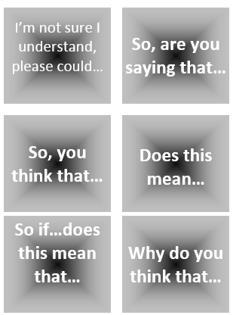
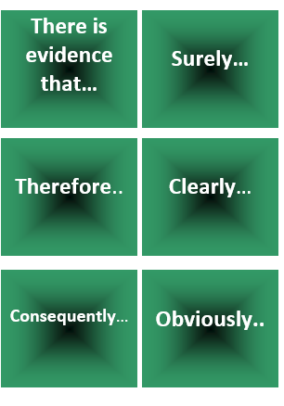
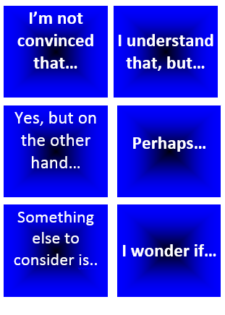
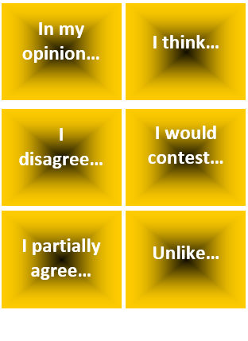
“The Internet is causing more problems for young people than it is solving”
Start with this card….
Or these cards….
Task 1: Discuss / Debate with your partner your own personal views towards this statement / idea.
Extension: Can you think of specific examples of recent events that would support this statement and other specific examples that would go against this statement?
Discussion task
2-3 Minutes
Notes:
TEACHER NOTES & IDEAS
Pair students up and have them use the sentence starter prompts on the board to help them (each colour represents a different set of prompts E.G Challenge, agree, build upon etc)
-Arrange for two confident students (or two pairs of students) to come to the front and have a debate challenge off with a timer
-Challenge a student to debate you (allow them to pick whether they will argue for the statement or against it)

Slide 14
!STOP!
Let us review our learning outcomes for this lesson
Knowledge, Skills & Actions
CONFIDENCE CHECKER
AFTER LEARNING | 1 | 2 | 3 | 4 | 5 | 6 | 7 | 8 | 9 | 10
I listen to my gut feeling about online situations and choices
I understand a wide range of risks associated with internet use
I know how to reduce the risks associated with ‘being online’
Complete the confidence checker of where you think you are at for this lesson (Discussion or complete sheet)
3 Minutes
I’m not confident at all
I’m getting more confidence
Confident
Very
confident
Super
confident
Notes:
TEACHER NOTES & IDEAS
This could be done by writing a number down in the books – Compare to the start of the lesson
Show of fingers in the air or use Red Amber Green Cards
Quick Partner Discussion & reflect on before the lesson and progress made
Print off the Assessment Opportunity Sheet – Fill in the Confidence Checker / Compare with the baseline
Author Attribution :https://pixabay.com/en/traffic-lights-traffic-light-phases-2147790/

Slide 15
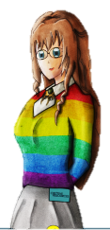
Enjoy the lesson, challenge your perceptions and, understand how to seek further advice and support
FOR MORE INFORMATION ABOUT THE TOPICS COVERED IN THIS UNIT WE WOULD ADVISE ONE OF THE BELOW: SPEAK TO YOUR PARENTS/GUARDIANS OR HEAD OF YEAR, TRUSTED ADULT OR A FRIEND, SEND A MESSAGE USING TOOTOOT IF YOU HAVE
ANY CONCERNS ABOUT YOURSELF OR SOMEONE YOU KNOW – IT IS ALWAYS IMPORTANT TO TELL SOMEONE! Visit https://www.saferinternet.org.uk/advice-centre/young-people/resources-11-19s
SPECIFIC FURTHER INFORMATION ON THIS TOPIC CAN BE FOUND HERE:
https://healthyyoungmindspennine.nhs.uk/resource-centre/apps/
https://www.mindcharity.co.uk/advice-information/how-to-look-after-your-mental-health/apps-for-wellbeing-and-mental-health/
https://www.internetmatters.org
2 Minutes
Notes:
TEACHER NOTES & IDEAS
Teachers should add in specific local signposting to charities, organizations or local NHS services in their area
Add / adapt or remove any suggested sites.
Print this slide and leave on door notice board after the lesson

Slide 16
I know if I need further
support or help I could
speak to…. or contact…
Before I could/would say
and do ... but now I feel I
am able to say…
Before I only knew ...
now I also know ...
I supported others by…
One thing I didn’t
realise was… now I know that…
The key words for
this lesson are…
I always knew ... but now
I can see how it connects to…
The most important thing I
have learnt today is…
I’m really proud of the
way I have…
I used to feel ...
but I now feel …
One assumption of
mine that was
challenged was…
I would like to learn…
A question I
would like to
ask is…
Before I thought that ...
but now I realise..
Today I have tried to…
Before I would have
said ... but now I will say…
Before I would have done…
Now I will …
A problem I overcame
today was…
2 Minutes
Notes:
TEACHER NOTES & IDEAS
: Have students pick either 1/2/3 tickets depending on their ability and tell a partner
Pick a few students at random to feedback to the class
As students leave the room have them tell you their reflection on the way out

