Slide 1

Women who changed the world

Slide 2
The history of International Women’s Day
The first IWD was held in March 1911 in Austria, Denmark, Germany, Switzerland.

Slide 3
Why does International Women’s Day happen?
Celebrating the achievements of women
Promoting gender equality

Slide 4

Women who changed the world

Slide 5
Florence Nightingale: 1820 - 1910
Florence Nightingale is famous for her nursing work during the Crimean War (1854 - 56).
She changed the face of nursing from a mostly untrained profession to a highly skilled and well-respected medical profession with very important responsibilities.
Her 1859 book, notes on nursing: what it is and what it is not, became one of the profession's most important texts.

Slide 6
Emmeline Pankhurst: 1858-1928
Emmeline Pankhurst was a founding member of a group of the Women’s Social and Political Union – more commonly known as the Suffragettes.
Her 40-year campaign achieved complete success in the year that she died, when British women got the right to vote.

Slide 7
Malala Yousafzai: 1997 - present day
When Malala was 11-years-old wrote an anonymous diary about what life was like under the rule of an extreme group called the Taliban in north-west Pakistan.
She was shot by the Taliban in 2012, when she was just 14-years-old, but continued her work and became the youngest person ever to win the world-famous Nobel Peace Prize.
She has gone on to win more awards, and continues to campaign for girls' rights all over the world and inspire many generations.

Slide 8
What do all these women have in common?

Slide 9
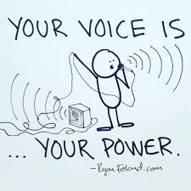

They used their voices to speak up and make the world a better place

Slide 10
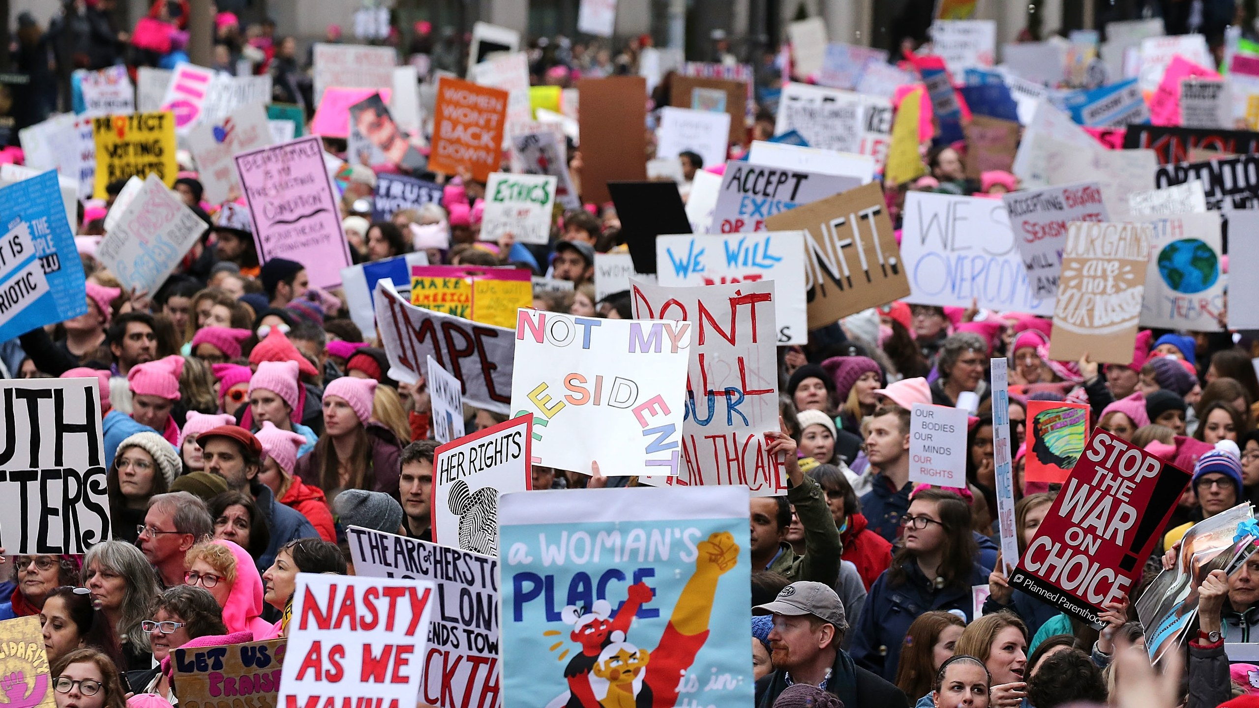

How can you speak up?

Slide 11

You can speak-up about anything that is making you or someone you know feel unsafe or unhappy using tootoot

Slide 12

tootoot is a safe and easy way to send a secure message to your school

Slide 13
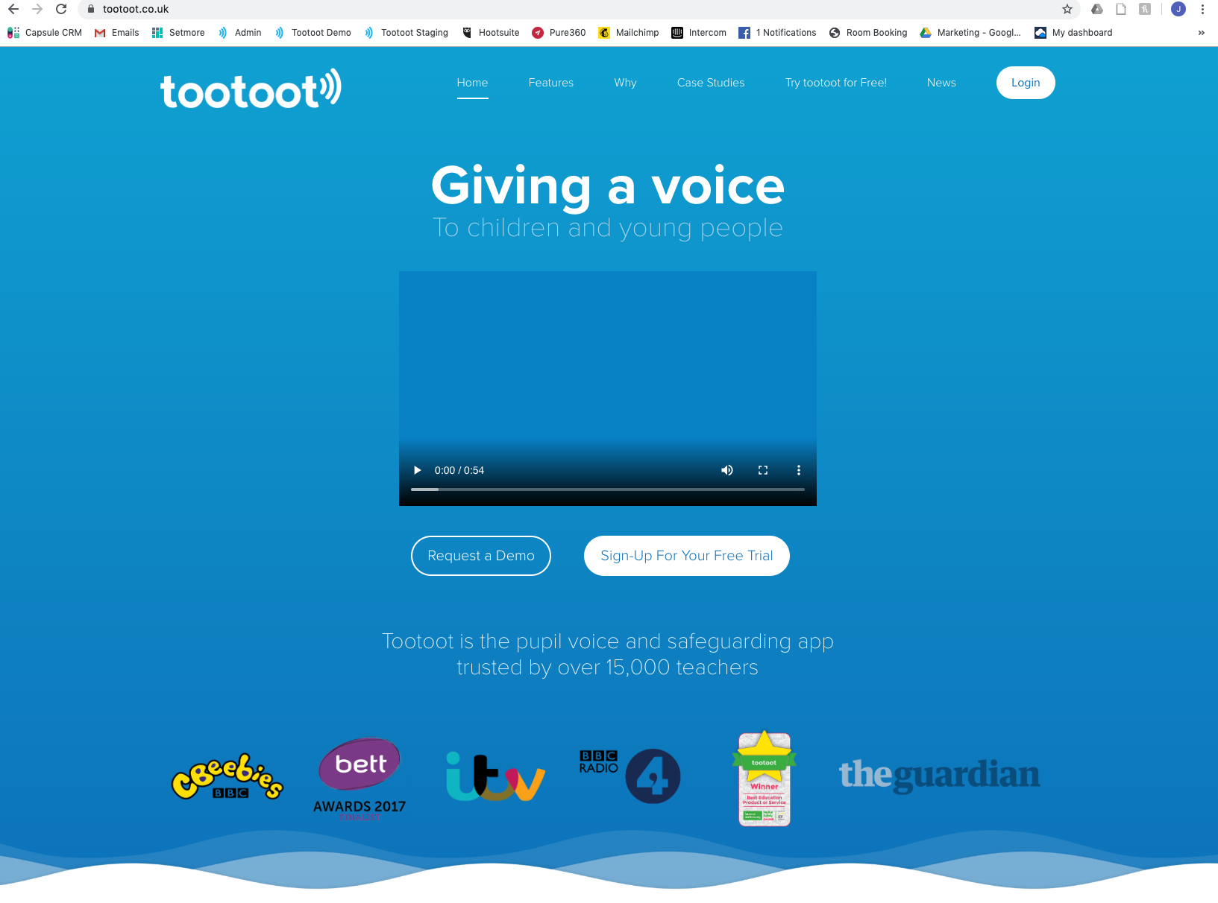
www.tootoot.co.uk

Slide 14
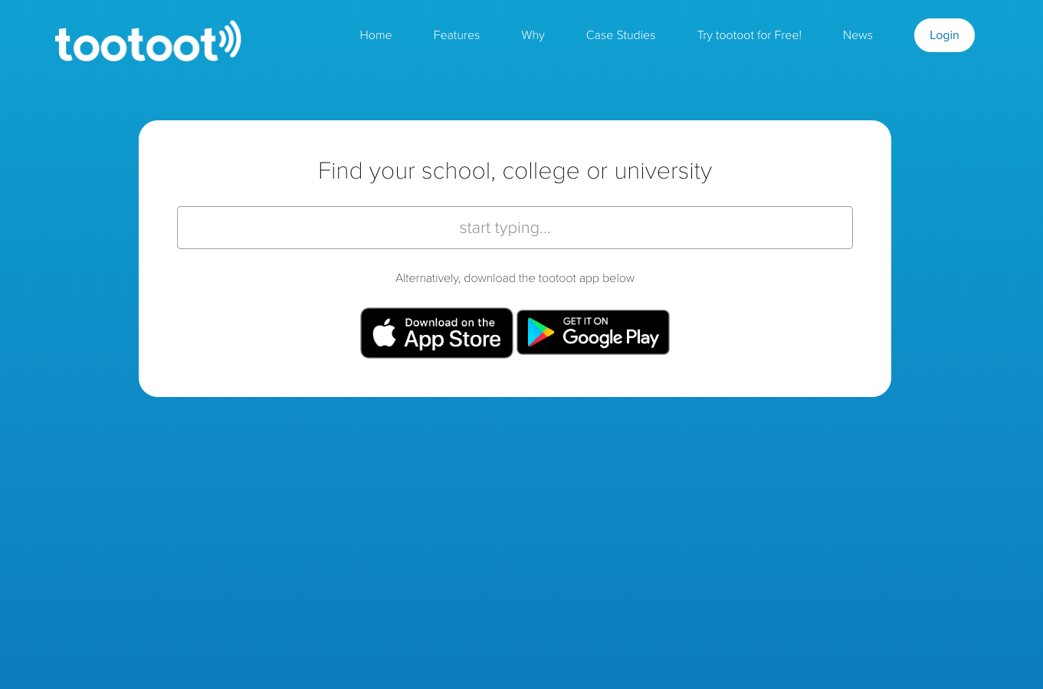
[INSERT SCHOOL NAME]

Slide 15
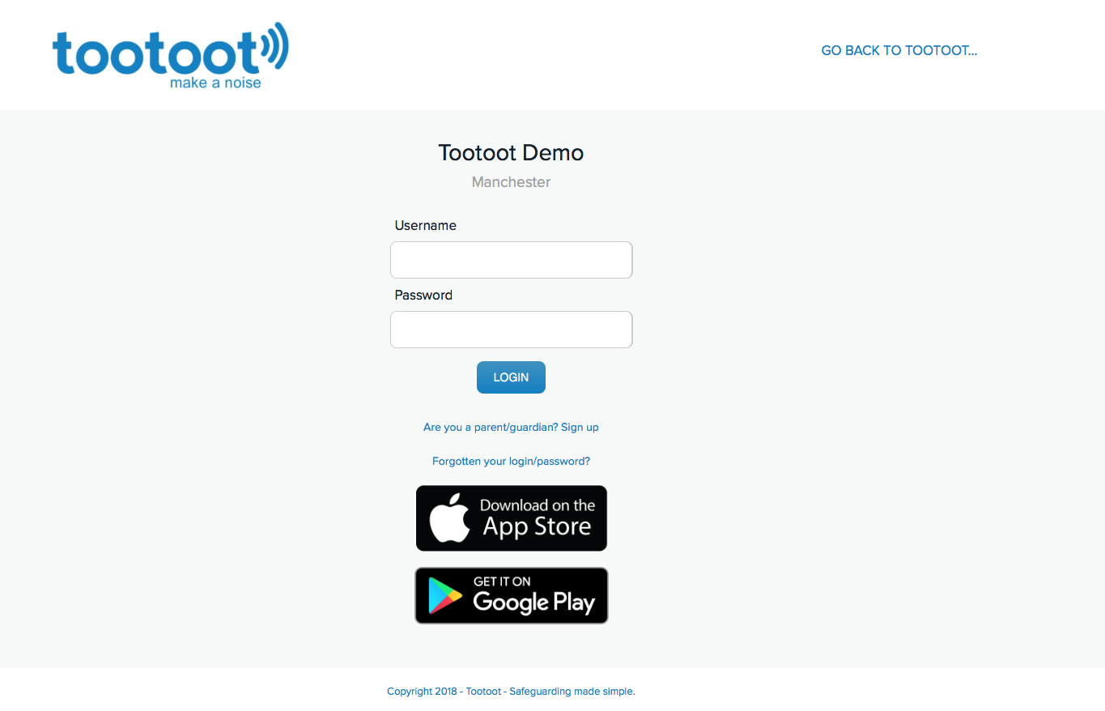
If you forget your tootoot login please speak to:
[INSERT TEACHER NAME]

Slide 16
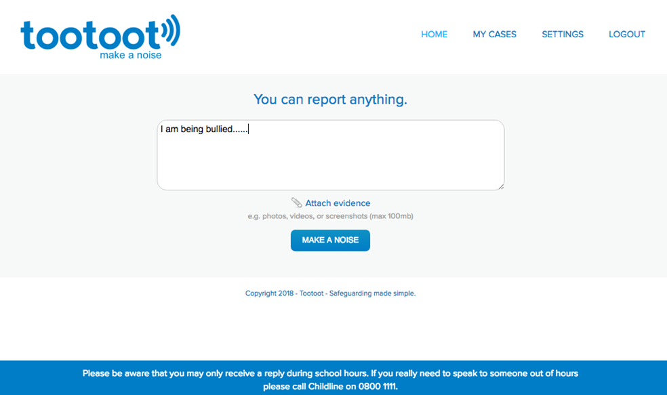
Attach screenshots, images or videos to your message

