Slide 1
Welcome Back to School
New Term, New Relationships

Slide 2
Assembly Objectives
To understand why positive relationships are important
To understand how to create and cultivate positive relationships
To be able to differentiate between bullying and banter.

Slide 3
Our relationships are diverse, and they are all important.
friends, classmates, teachers, parents, neighbours, colleagues

Slide 4
What qualities do positive relationships show?
Trust
Consent
Respect
Managing Conflict
Generosity
Privacy
Reconciliation
Kindness
Honesty
Boundaries

Slide 5
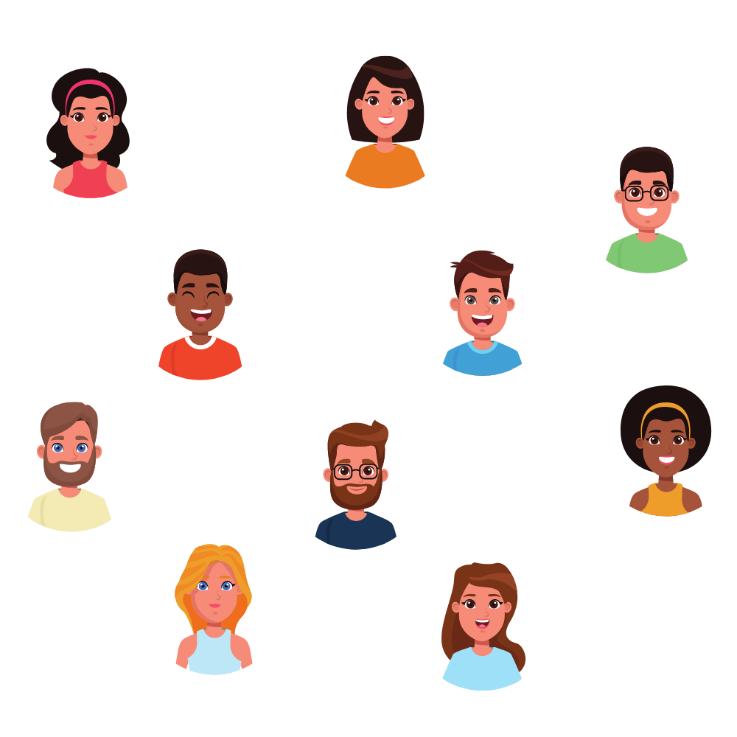
Why should we care about creating positive relationships?
Important for our wellbeing
Creates a strong school community where everyone can thrive
Helps us all become successful in life
Teaches us resilience
Builds our self-esteem

Slide 6
How can we create positive relationships?
Communicate with respect
Listen to each others’ perspectives
Take others’ perspectives into account as valid and meaningful
Adapt to individual needs
Engage in positive interactions
Accept conflict and disagreement as inevitable, and act to resolve this
Being aware of, valuing and responding to the other’s emotional state

Slide 7
What happens when we don’t have a positive relationship?
Conflict
Bullying
‘Banter’

Slide 8
What is the difference between bullying and banter?

Slide 9
Bullying vs. Banter
Banter
Bullying
Equal Power in the relationship
Usually:
There is no hurt involved
There is no intent to cause harm
The power relationship is uneven
This can happen when:
Maybe the person already told you they don’t like it.
You have involved more people
You target a specific aspect of their appearance or personality
This Photo by Unknown Author is licensed under CC BY-SA-NC

Slide 10
What can bullying be?
Passive-aggressive – negative gossip, deliberately causing insecurities or sabotaging someone’s wellbeing, social exclusion
Physical assault – intimidation, threat, harassment and/or harm
Verbal bullying – threats, shaming, hostile teasing, insults
Cyberbullying – bullying via social media, texting, video, email

Slide 11
1.5 million
The number of young people in the UK who have experienced bullying in the past year
1 in 8
young people have been bullied on social media

Slide 12
Hands up if you have ever witnessed banter

Slide 13
Hands up if you have ever witnessed bullying

Slide 14
Hands up if you have witnessed banter that you now think might be bullying

Slide 15
What can we do to stop bullying?
Be mindful about how our words and actions may affect the relationships we have with others.
Report any bullying to a trusted adult, teacher or tootoot - if it’s cyberbullying, screenshot the evidence and send to tootoot
Support each other, if you witness bullying or cyberbullying show some support to the individual so they don’t feel alone.

Slide 16
What is tootoot?
You can use tootoot to talk about anything that is making you feel unhappy or unsafe, no matter how big or small.
It is confidential!
Your message goes through to a trusted teacher who will help you.
You can login to tootoot at yourschoolname.tootoot.co.uk or download the app!
If you can’t remember your login please speak to teachersname who will help you reset it.

Slide 17
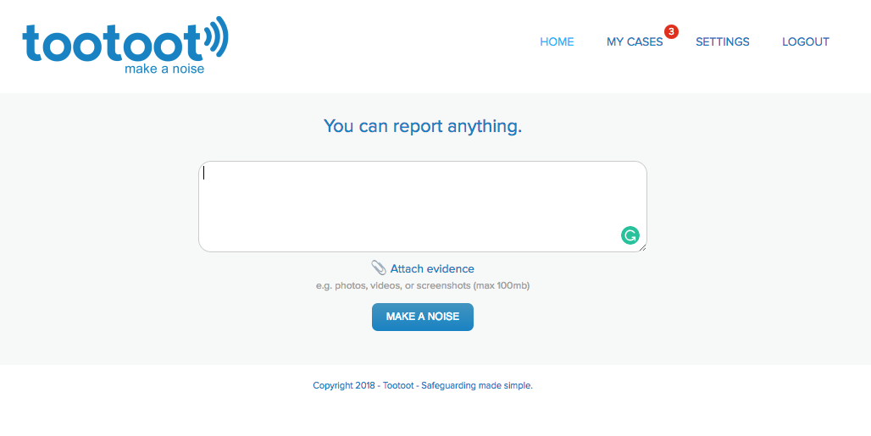
What is tootoot?

Slide 18
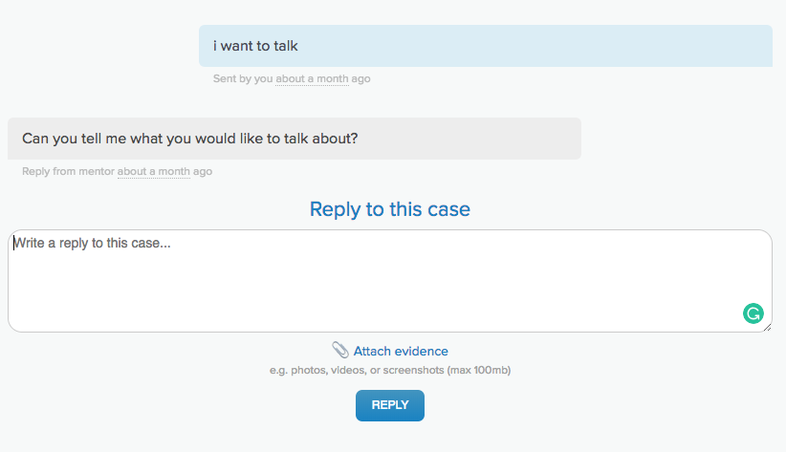
What is tootoot?

Slide 19
Summary
Maintaining positive relationships is important for our wellbeing and our community
If we don’t have a positive relationship this can lead to conflict or bullying
Bullying takes many forms, if you experience or witness bullying you should always tell a trusted adult, teacher or tootoot.

Slide 20
Thought for the day
Think about one relationship you have in school today. What will you do this week to make it more positive?

Slide 21
Thank you!
Any questions?

