Slide 1
Welcome Back to School!
Creating a Positive Community

Slide 2
Assembly Objectives
To learn about examples of community spirit during lockdown
To understand why we should care about creating positive communities
To be able to understand our own role in creating a positive community

Slide 3
As human beings we thrive in positive communities
Watch: Guardian News https://www.youtube.com/watch?v=up53FltNpsY

Slide 4
Do you have a similar story from lockdown you would like to share?

Slide 5
Why is creating a community important?
Makes us feel safe and secure
Gives us a sense of being a part of something bigger
Helps us achieve our goals
Improves our mental health and wellbeing
We learn new and exciting things!

Slide 6
Hands up, who has a suggestion or idea for ways we can continue that positive community feeling?

Slide 7
Communities look after each other.

Slide 8
It’s important we all play our part
Be kind to ourselves and others.
Look after each other, if someone doesn’t seem themselves ask them if they want to talk.
If you see bullying, check in with the person affected and then talk to a teacher, trusted adult or tootoot.

Slide 9
What is tootoot?
You can use tootoot to talk about anything that is making you feel unhappy or unsafe, no matter how big or small.
It is confidential!
Your message goes through to a trusted teacher who will help you.
You can login to tootoot at yourschoolname.tootoot.co.uk or download the app!
If you can’t remember your login please speak to teachersname who will help you reset it.

Slide 10
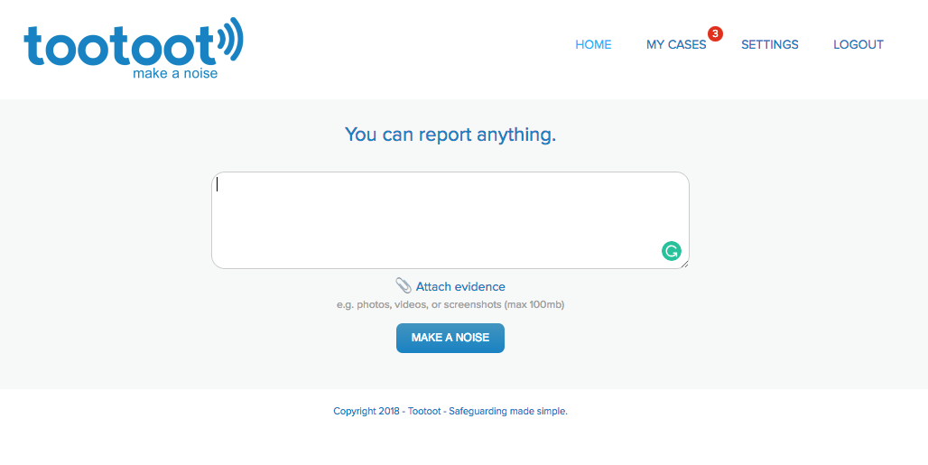
What is tootoot?

Slide 11
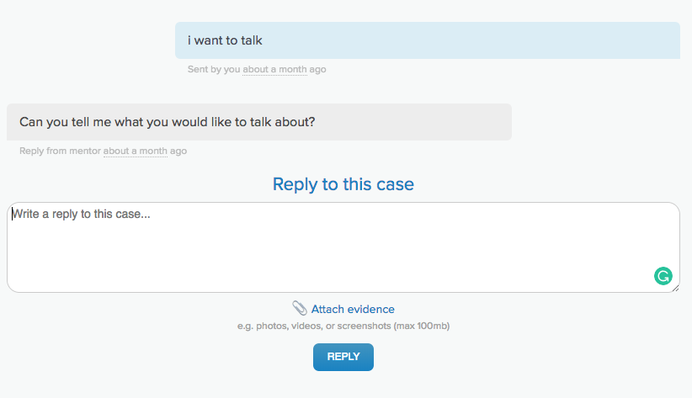
What is tootoot?

Slide 12
Summary
Being part of a community is important for our development, mental health and wellbeing
We are all responsible for creating a positive community, part of that is looking out for each other!
If we see something that makes us feel unhappy or unsafe, we should tell a trusted adult, teacher or tootoot.

Slide 13
Thought for the day
What can you do this week that will have a positive impact on your community?

Slide 14
Thank you!
Any questions?

