Slide 1
Friendship
Welcome Aboard!

Slide 2
Why do we need friends?

Slide 3
What qualities do you like about your friends?

Slide 4
Friendship qualities?
sense of humour
trust
honesty
good listener
supportive
reliability
Notes:
What order would these appear in if they were in order of importance?

Slide 5
Being a friend
American writer and poet Ralph Waldo Emerson once said:
“ The only way to have a friend is to be one.”

Slide 6
Friends can sometimes fall out, disagree or have arguments…

Slide 7
….but understanding and forgiveness are also great friendship qualities!

Slide 8
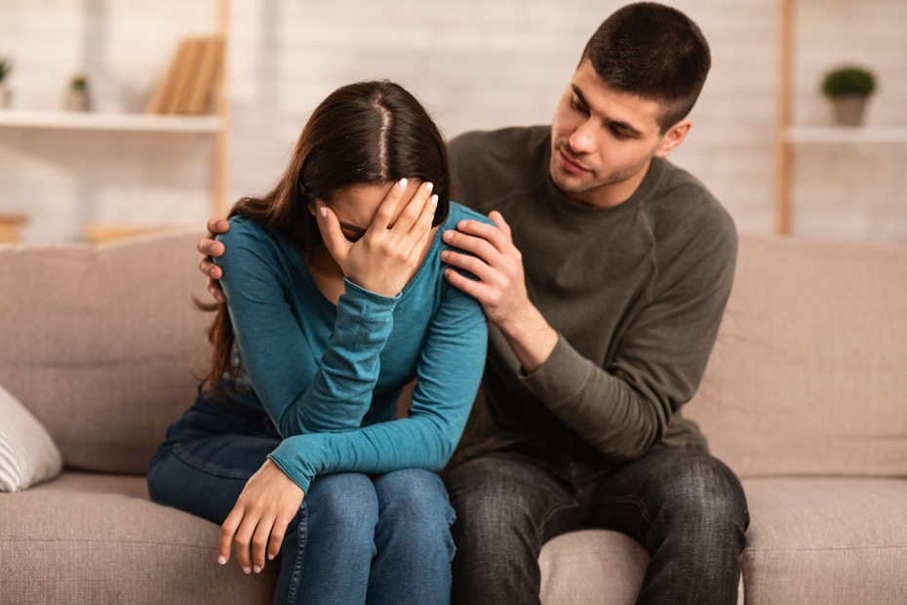
Friends can be there for you during happy times and difficult times.

Slide 9
How can we make it easier for each other to talk?
Check in with family and friends.
Listen and don’t judge.
Treat them in the same way, no matter what they say.
Ask “Are you ok?” twice

Slide 10
Getting advice and support from friends is a great way to make you feel better!
What else can you do if you have a problem or need to talk about something?
Talk to a Parent?
Talk to a Teacher?
Use tootoot

Slide 11
How can tootoot help?
Tootoot is a safe and private place to talk about anything that is worrying you.

Slide 12
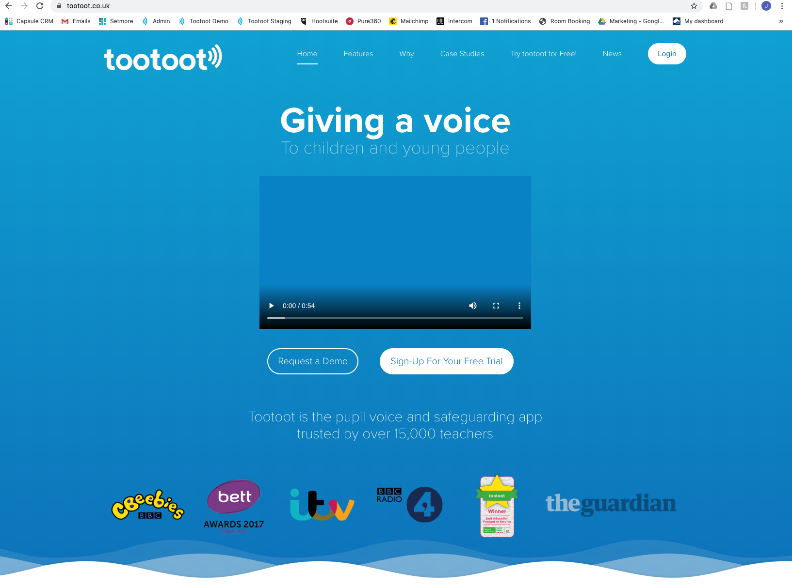

Slide 13
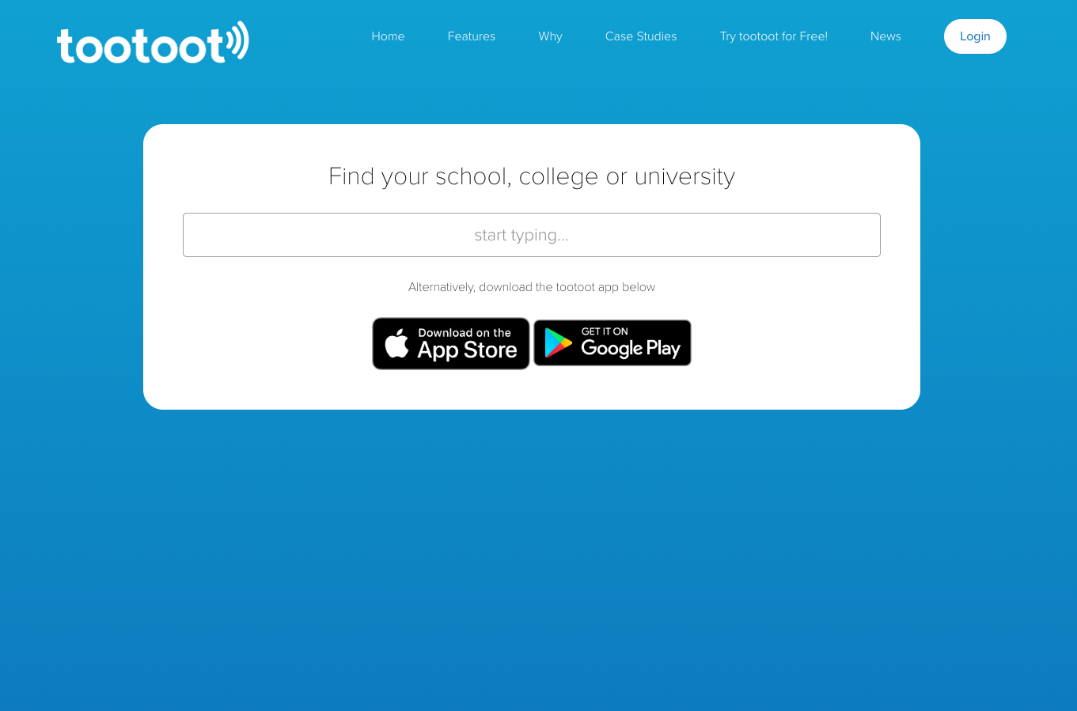

Slide 14
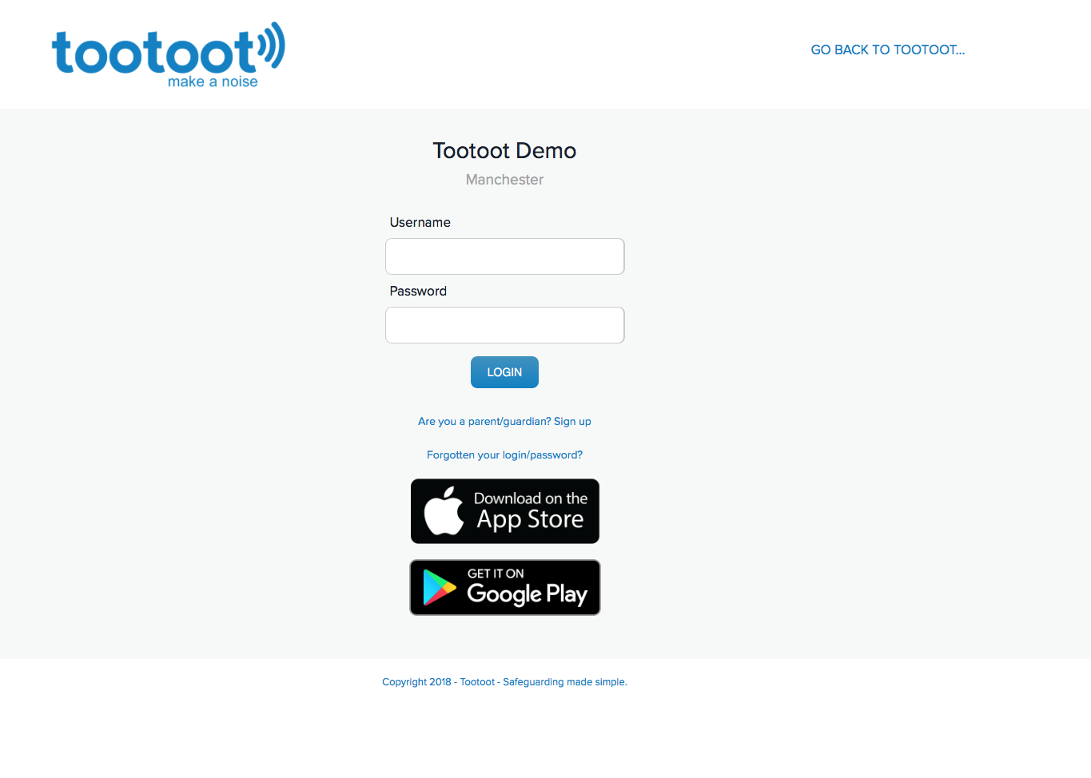

Slide 15
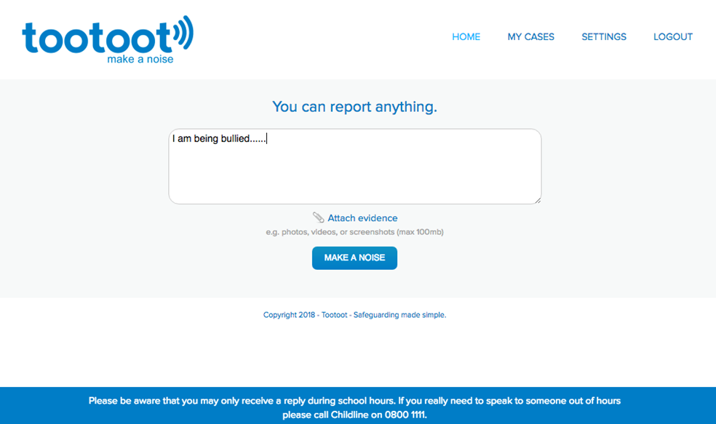

Slide 16
We are always here to support and help you if there’s anything that’s on your mind.
Always tell a teacher, a friend or tootoot if something is making you feel unhappy or unsafe.
If you forget your tootoot login please speak to [INSERT NAME HERE]

Slide 17
Any questions?

