Slide 1
ANTI-BULLYING WEEK 2021
'One Kind Word'

Slide 2
ACTIVITY!
Let’s see how much you know about bullying and the effects it can have on a student.
Hands up if you think the facts are true.

Slide 3
TRUE OR FALSE?
Within the past year 1.5 million children and young people have been bullied.

Slide 4
TRUE!

Slide 5
TRUE OR FALSE?
Bullying means that 74,000 children aged 5 - 19 are too scared to go to school.

Slide 6
FALSE!
Every day 160,000 children aged 5 to 19 are too scared to go to school.

Slide 7
TRUE OR FALSE?
27% of children who were bullied did not report it.

Slide 8
FALSE!
It is actually 64% of children who were bullied did not report it!

Slide 9
Turn to the person next to you and say ‘one kind word’. It could be something that describes their personality, appearance or it could be a word of encouragement.
ACTIVITY!

Slide 10
QUESTION
Why say something kind?

Slide 11
BEING KIND VS. BEING KIND
Being Kind
Being Unkind
Cheer someone up
Make someone feel bad about themselves
More likely that someone will be kind to you
Less chance of that person being kind to you
Could improve mental health for them AND you!
Could damage their mental health which can lead to long term challenges
Kindness fuels kindness. One kind word could lead to thousands! Let’s make the world a better place.
Being generally unkind can affect what people think about you and how they behave towards you.

Slide 12
KINDNESS FUELS KINDNESS
One kind word could lead to thousands!
Let’s make the world a better place!

Slide 13
ASSEMBLY CHALLENGE!
Say at least one kind word to five people by the end of today. If you are aware of anyone who may be struggling or not feeling great, make a point of delivering some kindness to them. It could turn their day around!

Slide 14
WHO CAN WE TALK TO?
Always talk to a teacher, a friend or tootoot! Even if you're unsure.
Support each other, if you witness bullying or cyberbullying show support to the individual so they don't feel alone
Report any bullying you see - if it’s cyberbullying, screenshot the evidence and send to tootoot

Slide 15
WHAT IS TOOTOOT?
You can use tootoot to talk about anything that is making you feel unhappy or unsafe, no matter how big or small.
It is confidential!
Your message goes through to a trusted teacher who will help you.
You can login to tootoot at tootoot.co.uk or download the app!
If you can’t remember your login please speak to your teacher who will help you reset it.

Slide 16
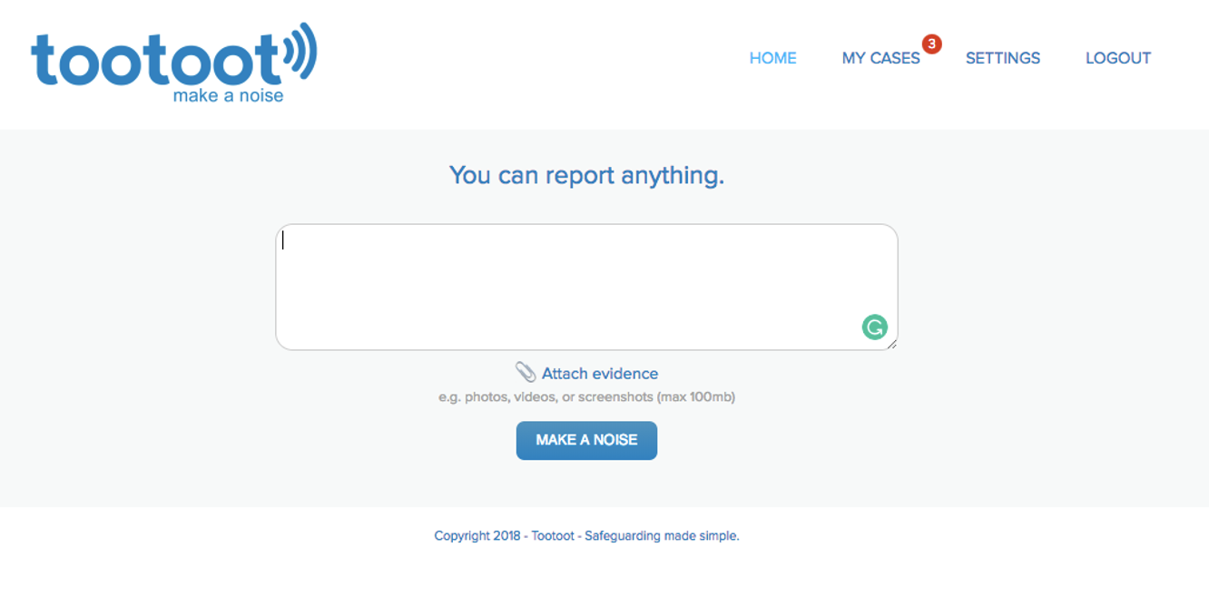
WHAT IS TOOTOOT?

Slide 17
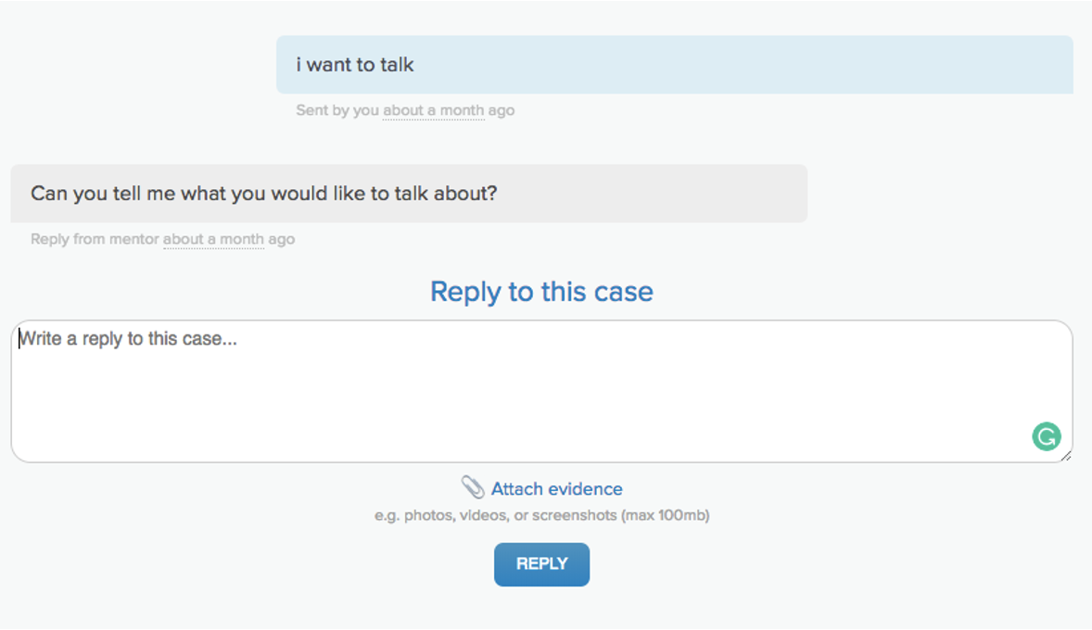
WHAT IS TOOTOOT?

Slide 18
ASSEMBLY REVIEW!
• Be kind! You never know when you’ll need it in return
• Being kind helps everyone feel better about themselves. There’s no reason not to do it!
• If you are being bullied, please talk to someone or use tootoot if you don’t feel comfortable doing so.

Slide 19
THANK YOU FOR LISTENING!

