Slide 1
Achievements
Going for goals!

Slide 2
Celebrating our achievements!
Achievement:
“a thing done successfully with
effort, skill or courage.”
“desire and determination to achieve success.”
Ambition

Slide 3
What achievements have
you made?

Slide 4
Do you have any big ambitions?

Slide 5
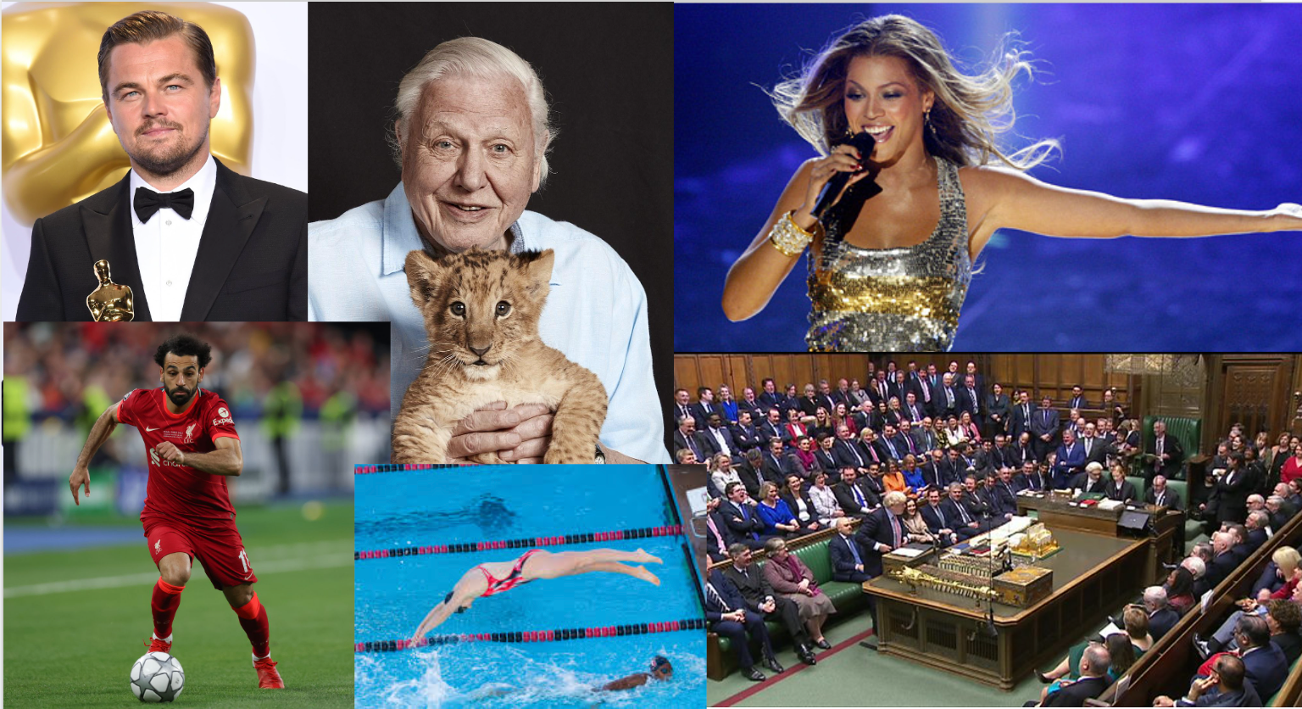

Slide 6
You can do anything you put your mind to
Set your sights on the goal you want to achieve
Find out how you can achieve your goal
Get the tools or the skills you need to achieve your goal
Give it your best shot!

Slide 7
try again
try again
try again
try again
try again
….but remember, if at first you don’t succeed……
try again
try again
try again
try again
try again
Success!
try again
try again
try again
try again
try again
try again
try again
try again
try again
try again
try again
try again
try again
try again
try again
try again
try again
try again
try again
try again
try again
try again
try again
try again
try again
try again
try again
try again
try again
try again
try again
try again
try again
try again
try again
try again
try again
try again
try again
try again
try again
try again
try again
try again
try again
try again
try again
try again
try again
try again
try again
try again
try again
try again
try again
try again
try again
try again
try again
try again
try again
try again
try again

Slide 8
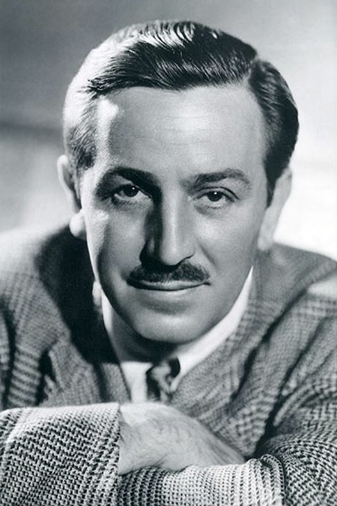
“There is no failure except in no longer trying”
These famous people experienced failure or rejection many times before achieving success:
Walt Disney - Animator, Film Producer
Created Mickey Mouse, Donald Duck and Goofy.
Produced many beloved animated films such as Cinderella, Pinocchio, and Alice in Wonderland
Winner of 26 Academy Awards
“Not creative enough!”

Slide 9
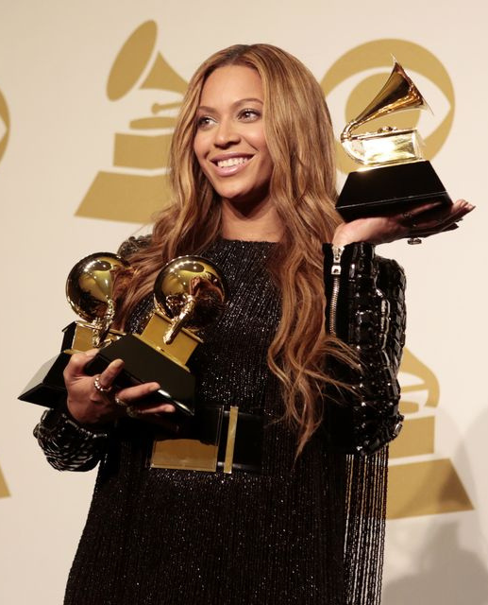
“There is no failure except in no longer trying”
These famous people experienced failure or rejection many times before achieving success:
Beyoncé Knowles – Singer, Songwriter
5 UK Number 1 Singles and 4 UK Number 1 Albums
Inspired many other stars including Lady Gaga, Rihanna and Adele
Winner of 28 Grammys and 29 MTV Video Music Awards
Lost a national tv talent show.
Dropped by record company.

Slide 10
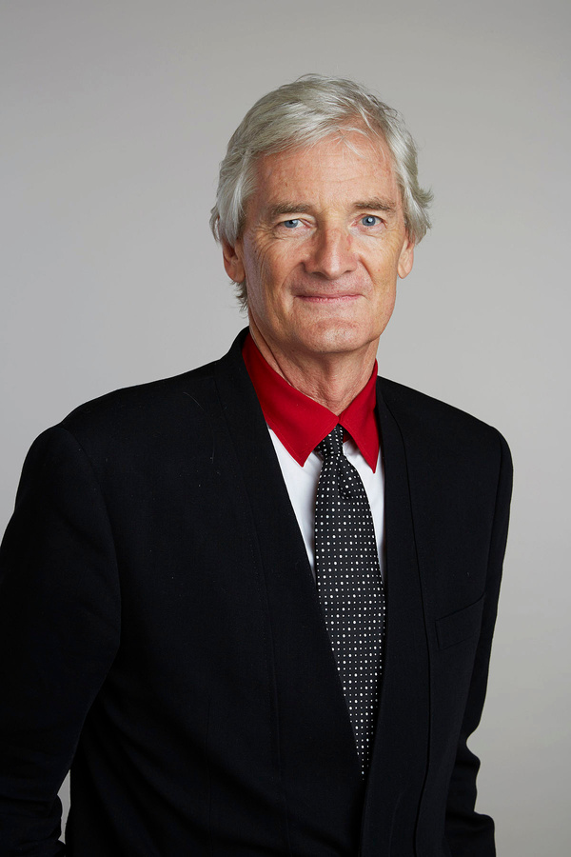
“There is no failure except in no longer trying”
These famous people experienced failure or rejection many times before achieving success:
James Dyson – Designer, Inventor
Inventor of the bagless vacuum cleaner. Now in most homes worldwide
Founder of Dyson Ltd – household appliance manufacturer
2nd richest person in the UK. Net worth: £23 billion.
Over 5000 failed prototypes

Slide 11
Getting advice and support is a great way to help you achieve your goals.
Talking to someone about your worries can also help make it easier to focus on the task you have set yourself.
What else can you do if you have a problem or need to talk about something?
Talk to a Parent?
Talk to a Teacher?
Use tootoot

Slide 12
How can tootoot help?
Tootoot is a safe and private place to talk about anything that is on your mind.

Slide 13
www.tootoot.co.uk

Slide 17
We are always here to support and help you thrive this new school year.
Always tell a teacher, a friend or tootoot if something is making you feel unhappy or unsafe.
If you forget your tootoot login please speak to [INSERT NAME HERE]

Slide 18
Any questions?

