Slide 1
Anti-bullying Week
Reach Out

Slide 2
“In any moment of decision, the best thing you can do is the right thing, the next best thing is the wrong thing and the WORST thing you can do, is nothing.”
-Theodore Roosevelt, United States President 1901 - 1909

Slide 3
What are the negative impacts on someone who is experiencing bullying?
Depression
Anxiety
Loneliness
Lack of confidence
Sleeping problems
Eating problems
Apathy

Slide 4
An episode of bullying may only last a few days or weeks.
But the negative impacts are often carried into adult life. And may even be permanent.

Slide 5
What can you do if you are experiencing bullying?
What can you do if you know someone is being bullied?

Slide 6
Tell a
parent

Slide 7
Tell a
teacher

Slide 8
Tell a
friend

Slide 9
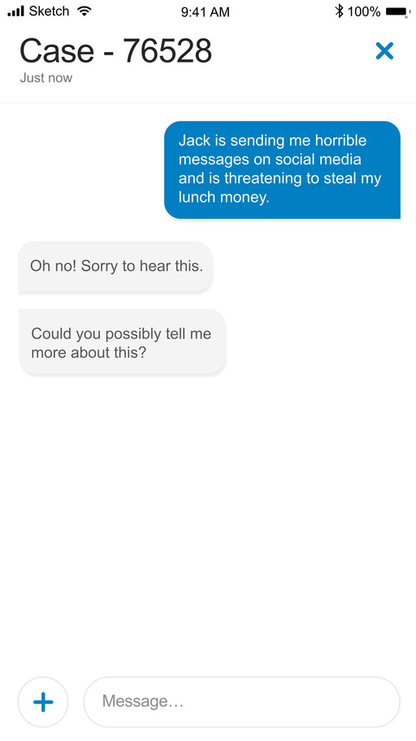
Tell
tootoot

Slide 10
Pause for thought....
Have you ever been mean or nasty to someone?
How did it make you feel?
How could you have done things differently?

Slide 11
Many victims of bullying find it very difficult to tell anyone. Meaning they suffer for longer.
We ALL have a duty to stamp out bullying. If you know someone is being bullied, tell someone or use tootoot.

Slide 12
Bullying rarely stops by itself. Usually, some kind of intervention is required.
The most important thing you can do is reach out and tell someone.
It’s not about getting someone in trouble, it’s about getting yourself out of trouble!

Slide 13
If you find it too hard to tell someone face-to-face, you could call a helpline, such as Childline or The Mix.
Or you can use tootoot to confidentially and anonymously report bullying to your school.

Slide 14
Assembly Review
The impacts of bullying can be destructive and long lasting.
Be kind and respectful at all times. To all people.
If you are being bullied, please talk to someone or use tootoot if you don’t feel comfortable doing so. Either way…..
Reach Out

Slide 15
Any questions?

